Slide 1
Problem statement
From the large company websites, local shops will loss their customers.
Small stores are not able to extend their marketing range so this path would help them.
The existing marketing apps are not able to provide proper services in rural areas on time by shipping problem.
People are unable to get the service from their wished shops.
And also to the shop owners who are not able to get their shop to online it will be useful.

Slide 2
General information
This project is based on ON-LINE marketing, and the reason behind it is:
To provide a satisfactory delivery to the consumers from their interested shops only.
And this project helps to the people who are not able to shop in offline .
By this project we can build a network from rural to urban area.
And introduce the new products from rural to urban area .

Slide 3
How it works,
Initially, Consumer and shop owner both should download the application from the play store.
After that both the categories would have different tabs to operate the app.( consumer tab and service provider tab)
when the consumer place a order in the app the notification will pop-up in shop owners mobile, then shop owner should acknowledge the button if he can provide a service to them if not reject the proposal.

Slide 4
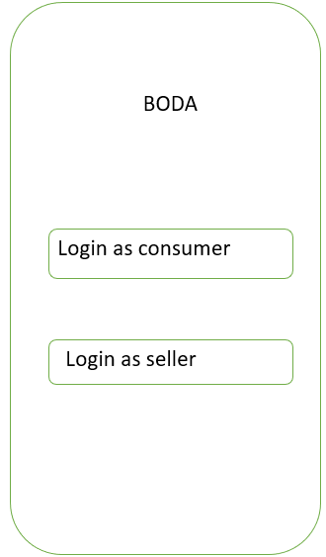
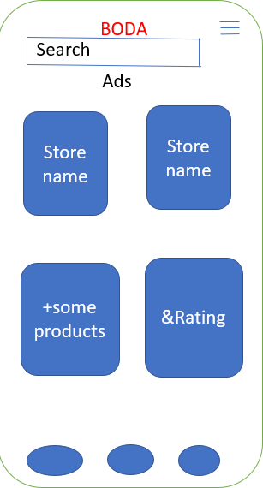
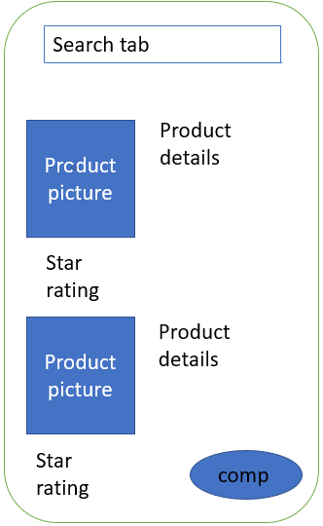
Executive summary

Slide 5
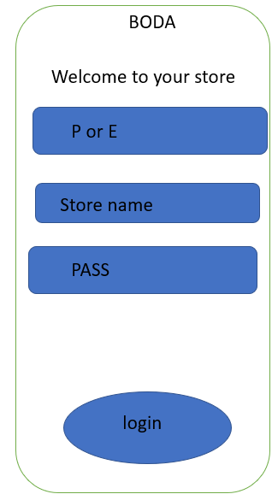
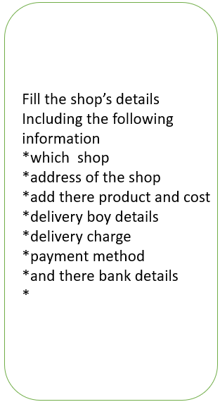
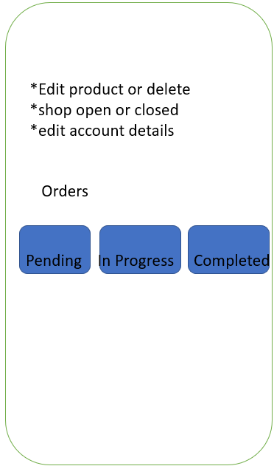








Cont…..

Slide 6
Marketing plans
We should mainly target the customer who aren’t able to shop off-line.
Social media platforms.
By pasting the pamphlets on the shops itself.
And “refer and earn” concept to improve the download quantity.

Slide 7
Revenue model
Subscription & Membership Plans
Advertising & Marketing

Slide 8
Features
Order food, groceries, and other items
Order from your favourite shops
Track your order progress and see where your courier is
Helps connect restaurants or shops and customers
Quick delivery at a low cost
Read customer reviews and menus and order what looks good
Notification of order progress
Pay through the app or pay cash at the door

Slide 9
Challenges to start the project
Publishing the app
Miss using of the app
Quality issues
Unstable market prizes
Lack of expert to built a application.

